Slide 1



Credit Card Fraud Detection Machine Learning
Andrew Ieong
Joanne Mannuella
Suraj Shrestha

Slide 2

PROBLEM STATEMENT AND BACKGROUND

Slide 3
PROBLEM STATEMENT AND BACKGROUND
Problem Statement :
"Americans reported 271,823 cases of credit card fraud in 2019. This is an increase of 72.4 percent from 2018, when there were 157,715 cases of credit card fraud reported."
"Losses from fraud involving cards used for payment worldwide reached $27.85 billion in 2018. They are projected to rise to $35.67 billion in five years and $40.63 billion in 10 years."
Therefore to avoid this manual filtering process can be lengthy and costly process, it will required time and human resources, when business these day wouldn't have enough resources to do so.

Slide 4

PROBLEM STATEMENT AND BACKGROUND
To put into context
most payment for business are made online and the payment are made with credit card. Everyday there are millions of credit card transaction.
Businesses is trying to predict which transaction is legitimate and lowering the risk of fraudulent transaction. In this project we decided to develop a supervise machine learning .
Goals :
To eliminate process of manual filtering process and increase efficiency by developing machine learning to predict the fraudulent transaction with high accuracy. To help businesses to focus on other areas so business can achieve other goals.
Our Target :
0: non-fraudulent
1: fraudulent transaction

Slide 5
What to Know
Data Source and Data Cleaning
Analysis and Model Fitting
Conclusion
Challenges and Recommendations

Slide 6


Data Source and Coding References

Slide 7
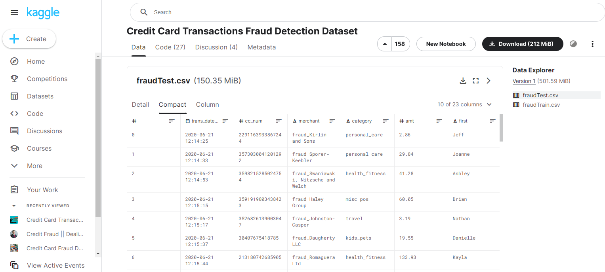

Data Source
https://www.kaggle.com/datasets/kartik2112/fraud-detection ↩
https://github.com/sharmasapna/credit-card-fraud-detection/blob/main/credit-card-fraud-detection.ipynb ↩

Slide 8


Data Cleaning Process and Data Preperation

Slide 9
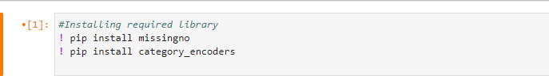
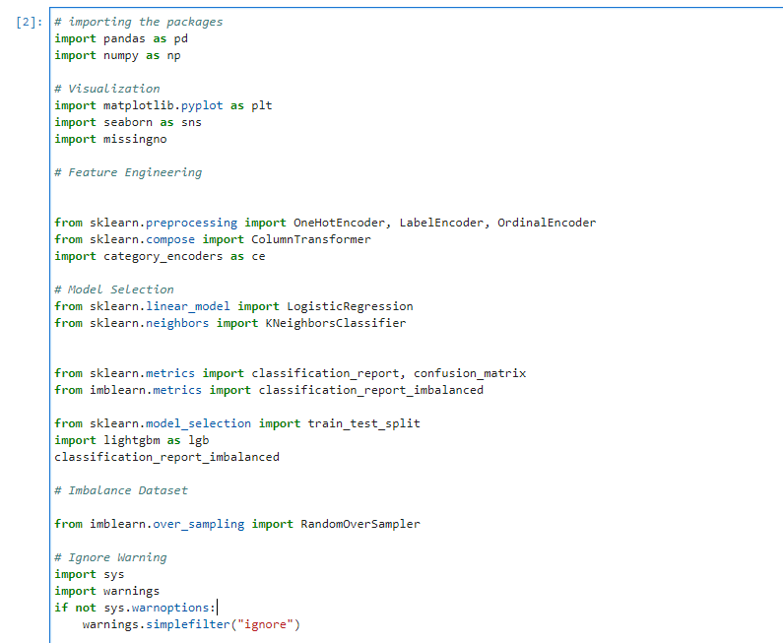
1.Import and Installing Library

Slide 10
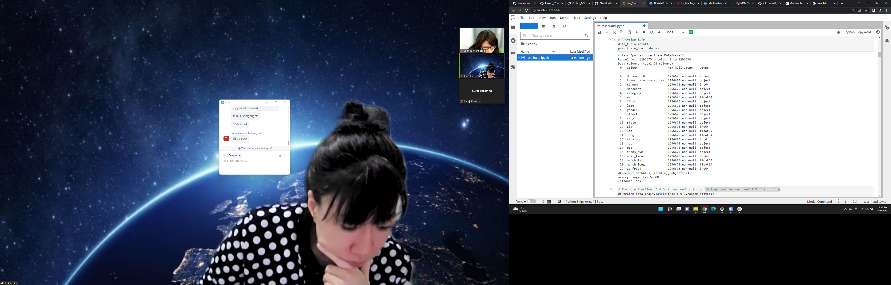
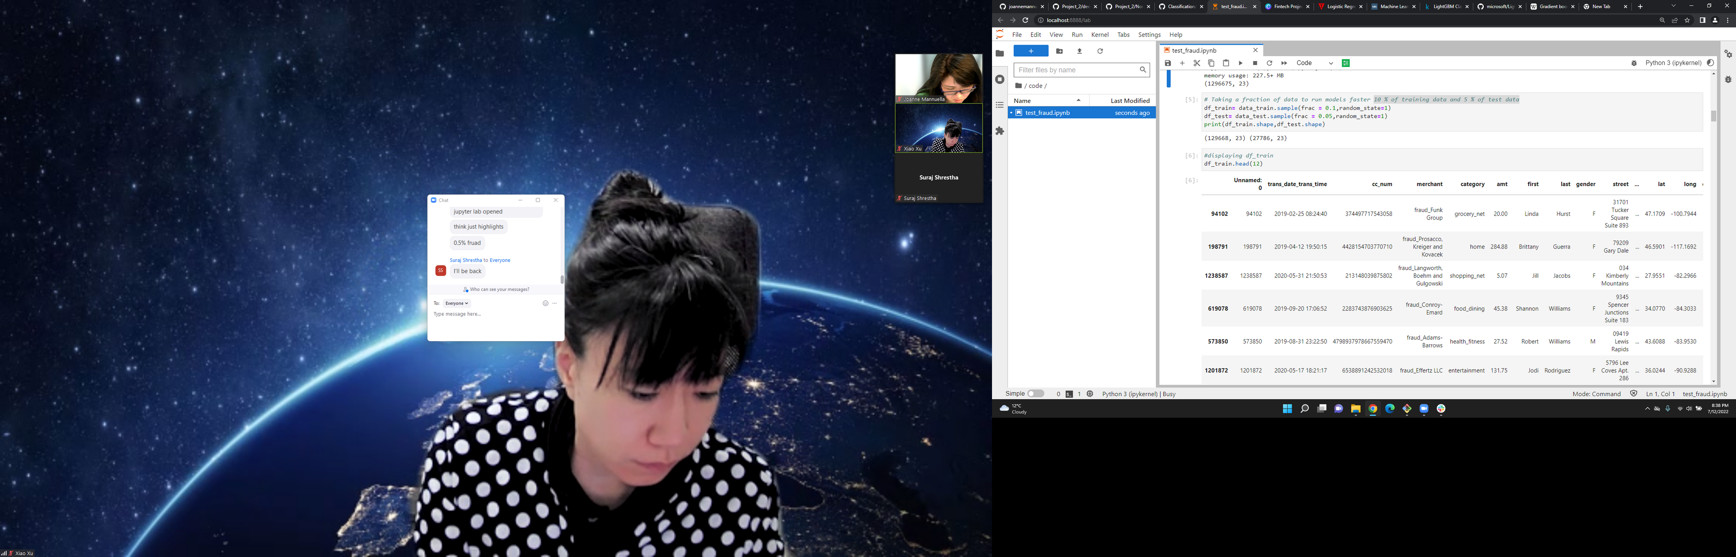
2. Slicing the Data
Slicing the data by taking only Fraction of data after printing the info .
Data frame consist of 1,296,675 rows and 23 columns.
to run faster model we using 10 % of training data and 5 % of test data from original data frames.

Slide 11
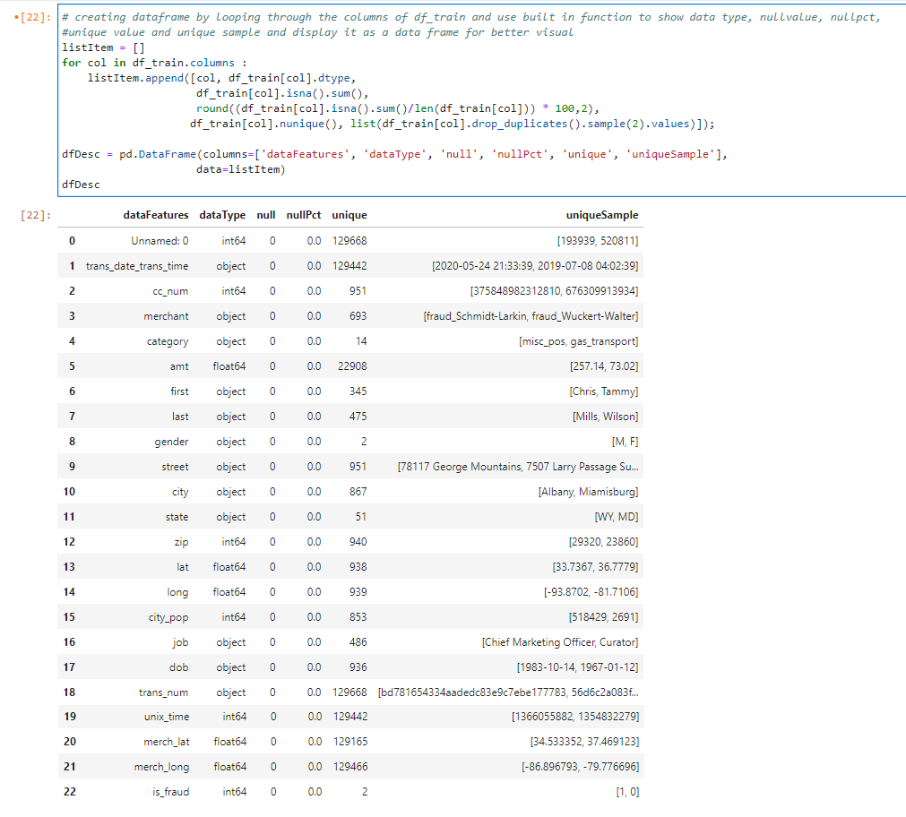
3. Visualisation of data for data preperation
Creating a data frame by looping through the columns by using built-in function the reason of this is for a better visualisation :
1. Data type
2. Nullvalue
3. Nullpct
4. Unique value and unique sample

Slide 12
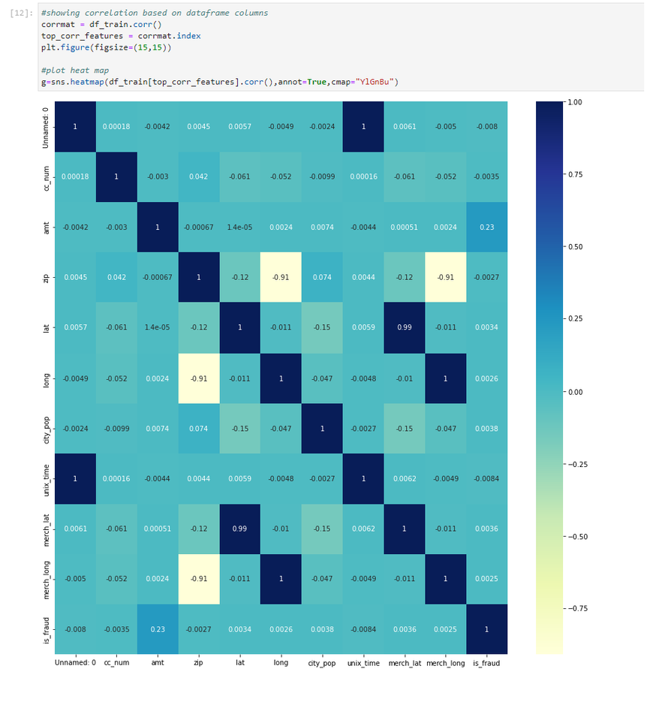
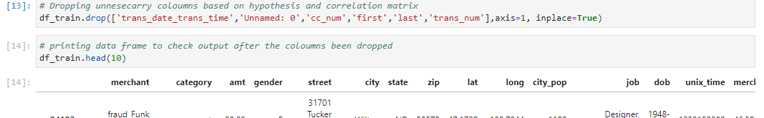
4. Drop and Determining unnecessary features
Plot correlation matrix to help gauging between columns to drop unnecessary columns also applying simple logic to determine the features
The columns we drop:
"Unnamed" because it only contains indexes and is not useful to our machine learning.
Second we will dropped "trans_date_trans_time" since we have unix_time
The third column customer card number .
We will dropped "first name" and "last name" dropped.
Transaction number is it really necessary? we also think it won't be really needed.

Slide 13
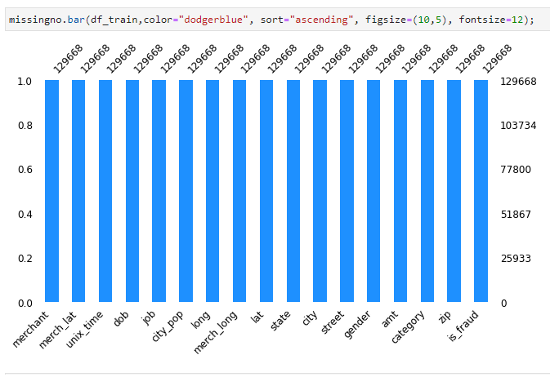
5.Using missingno function to plot that current columns doesn't have missing value.

Slide 14
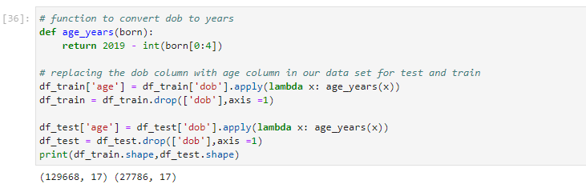
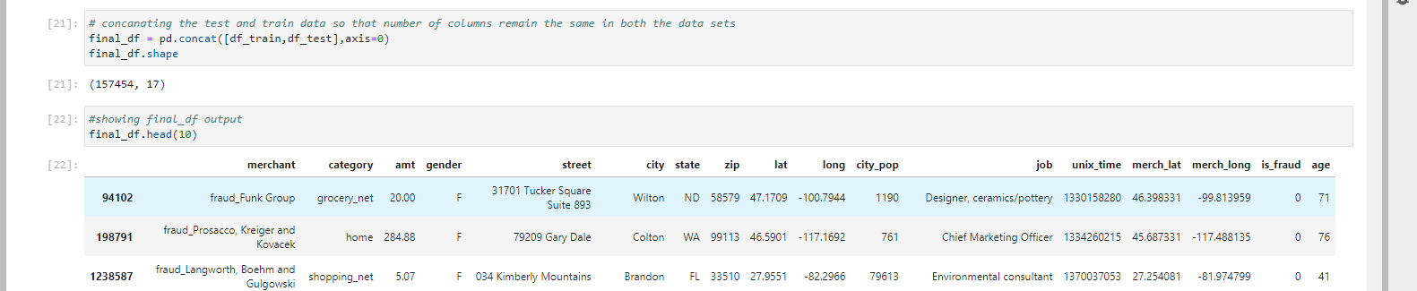
6. Convert the DOB to age, concat the test and train data so that number of columns remain the same in both the data sets.

Slide 15
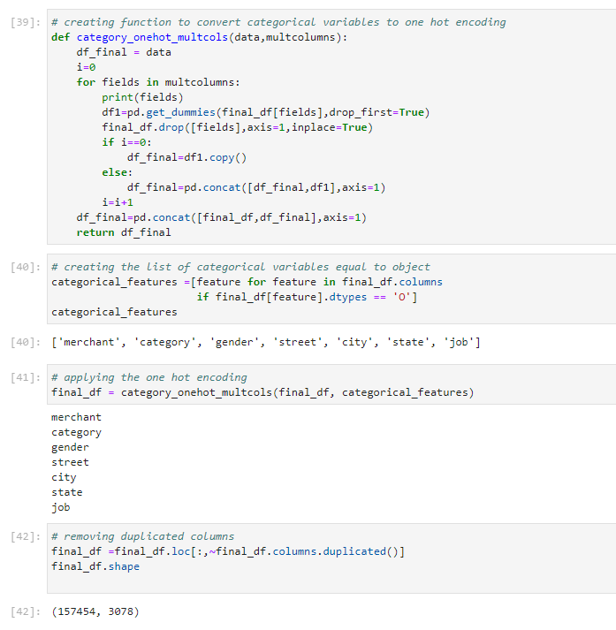
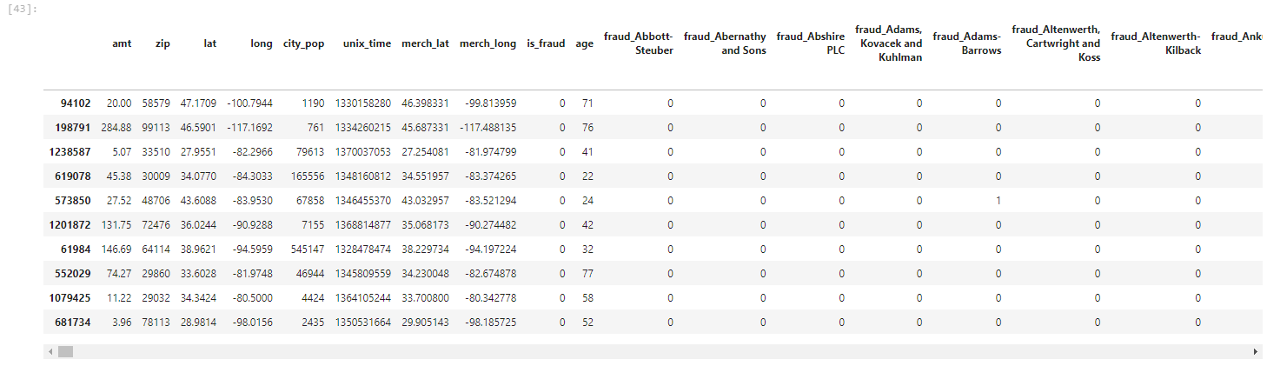
7. Creating a function to convert categorical variables to one hot encoding

Slide 16
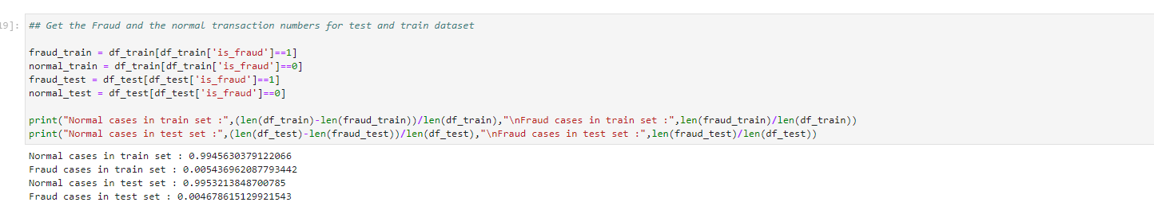
8. Looking at Data Distribution
The figure show that the data is imbalance, meaning there is not equal distribution of
0: non-fraudulent
1: fraudulent

Slide 17


Analysis and Model Fitting

Slide 18
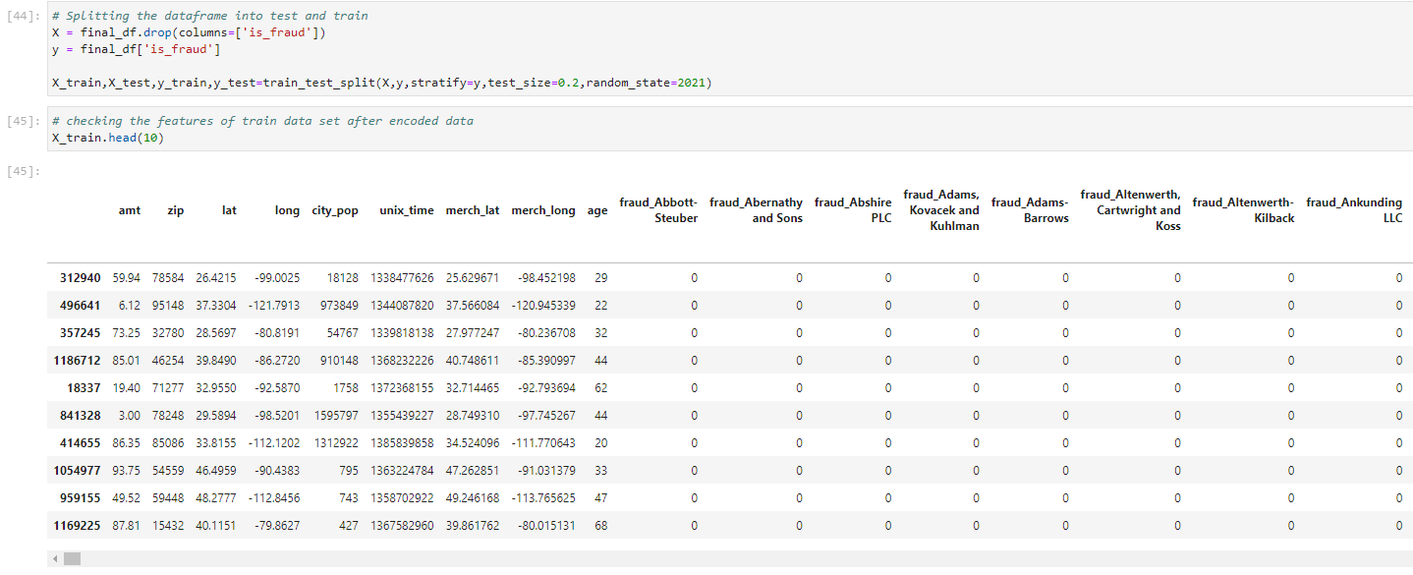
Spliting dataset Into Train and Test using sklearn library from
sklearn.model_selection import train_test_split

Slide 19
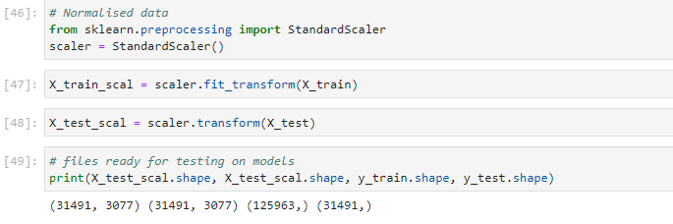
Normalise data to train machine model

Slide 20
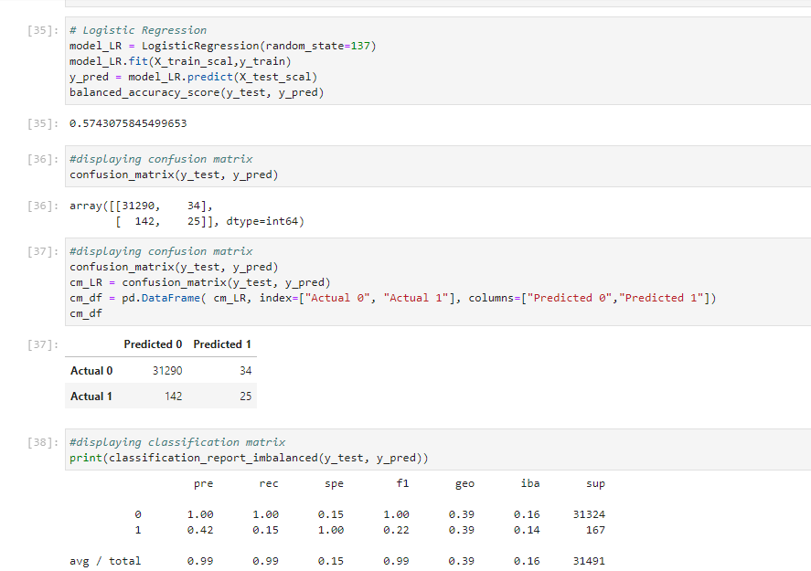
Logistics Regression Model using Imbalanced Dataset.
Logistic regression is one of the most popular Machine Learning algorithms, which comes under the Supervised Learning technique. It is used for predicting the categorical dependent variable using a given set of independent variables.
Findings: We fit our model, this mode showed that the precision and accuracy is very high, but the data set is imbalance making this model bias.
https://www.javatpoint.com/logistic-regression-in-machine-learning#:~:text=Logistic%20regression%20is%20one%20of,of%20a%20categorical%20dependent%20variable.

Slide 21
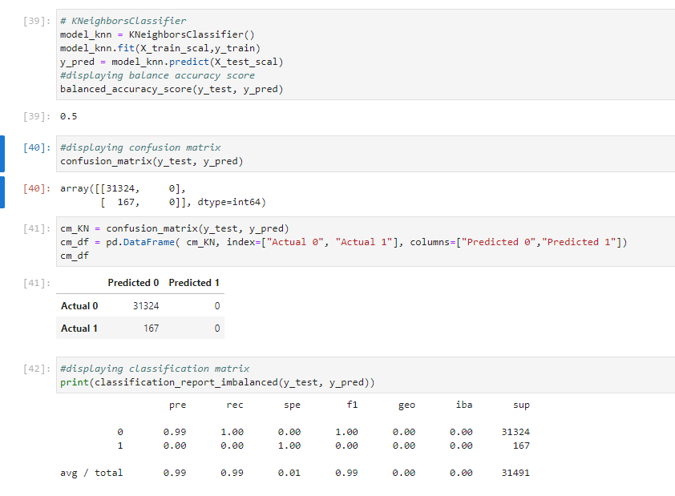
Second Machine Model: KNeighboursClassifier using Imbalanced Dataset.
The KNN algorithm assumes that similar things exist in close proximity. In other words, similar things are near to each other.
Findings: Same like Logistic regression model our KNeighboursClassifier model precision and accuracy is very high, but we can see it didn't pick up any fraudulent transaction due to the nature of KNeighbour classifier also due to our imbalance data frame making this model ineffective to fulfill our target.
https://scikit-learn.org/stable/modules/generated/sklearn.neighbors.KNeighborsClassifier.html

Slide 22
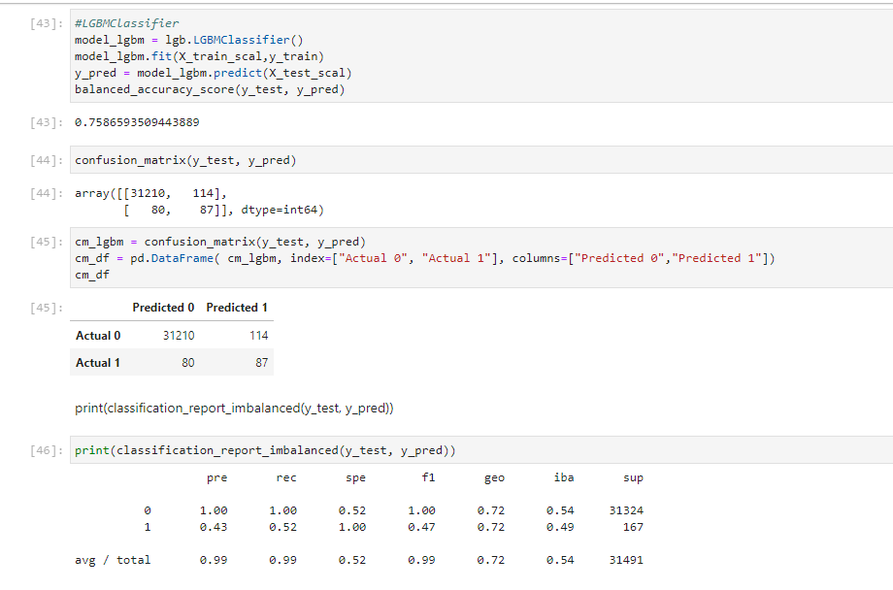
Third Machine Model: LGBMClassifier using Imbalanced Dataset.
Findings: Same like Logistic regression model and KNeighboursClassifier model precision and accuracy is very high, but due to imbalance data set making this a bias model
https://www.kaggle.com/code/prashant111/lightgbm-classifier-in-python/notebook

Slide 23
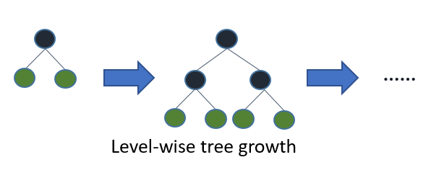
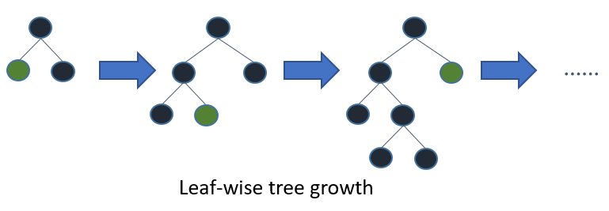
Third Machine Model: LGBMClassifier using Imbalanced Dataset.
LightGBM is a gradient boosting framework that uses tree based learning algorithm. the model grows tree vertically while other tree based learning algorithms grow trees horizontally. It means that LightGBM grows tree leaf-wise while other algorithms grow level-wise. It will choose the leaf with max delta loss to grow. When growing the same leaf, leaf-wise algorithm can reduce more loss than a level-wise algorithm.
Gradient boosting is a type of machine learning boosting. It relies on the intuition that the best possible next model, when combined with previous models, minimizes the overall prediction error. The key idea is to set the target outcomes for this next model in order to minimize the error.
https://www.kaggle.com/code/prashant111/lightgbm-classifier-in-python/notebook
https://www.kaggle.com/general/264327

Slide 24


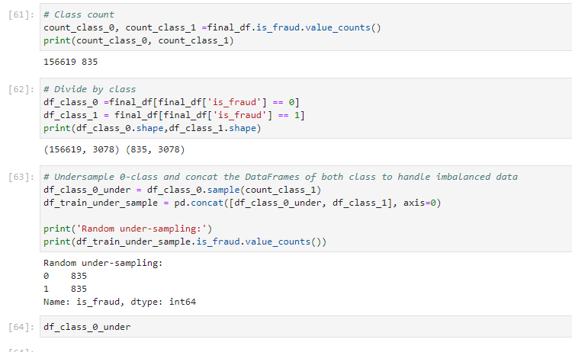
Balance is Key!!
Handling the imbalance data by applying random under-sampling

Slide 25
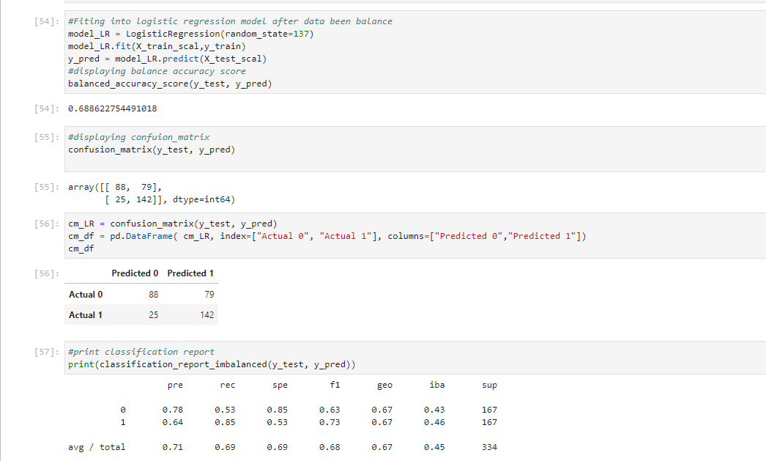
Fitting the Balance data into Logistics Regression Model.
Findings: This model show although the average accuracy and prediction is less compared to imbalanced data, but it showed improvement of the prediction of 1(fraudulent) from 0.42(42%) to 0.64(64%) which is our main goal of developing this Machine Learning .

Slide 26
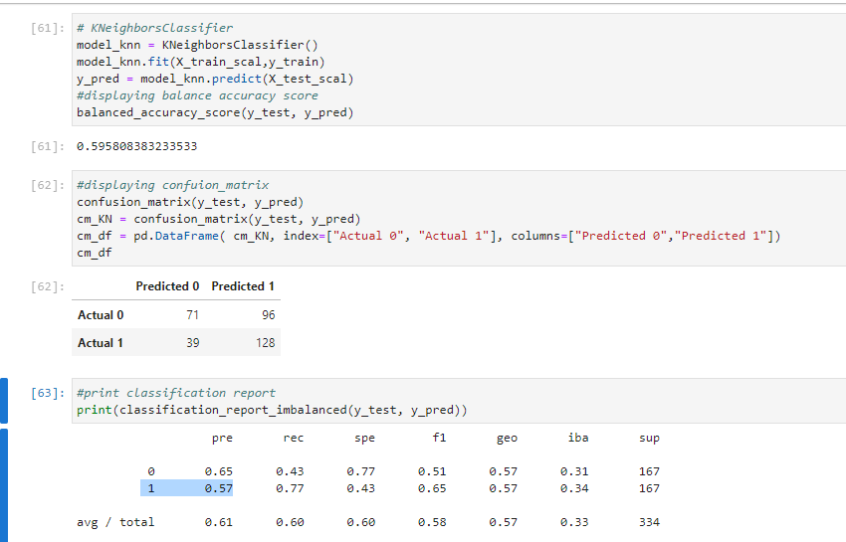
Second Machine Model: KNeighboursClassifier Balanced Dataset.
Findings:
This model show although the average accuracy and prediction is less compared to imbalanced data, but it showed improvement of the prediction of 1(fraudulent) from 0%(0%) to 0.57(57%) which is our main goal of developing this Machine Learning .

Slide 27
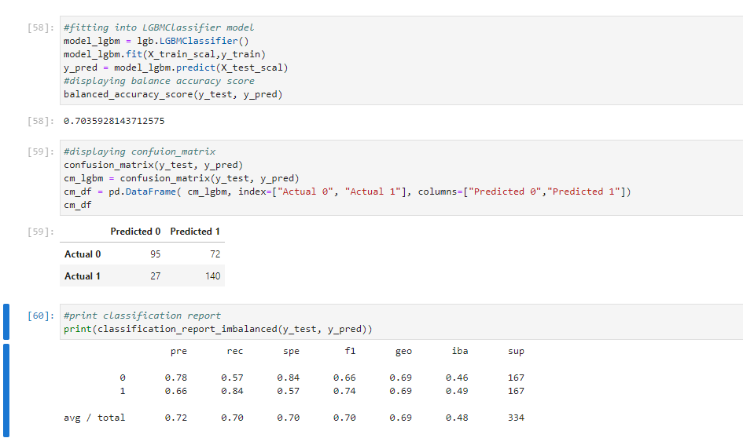
Third Machine Model: LGBMClassifier
Findings:
This model show although the average accuracy and prediction is less compared to imbalanced data, but it showed an improvement of the prediction of 1(fraudulent) from 0.43%(43%) to 0.66(66%) which is our main goal of developing this Machine Learning.

Slide 28
Performance measures for Imbalanced Classes metrics explain:
Specificity it is also known as True Negative Rate. It is the ratio of correctly predicted negative classes to the total actual negative classes. The formula for specificity is
The recall means "how many of this class you find over the whole number of element of this class"
The precision will be "how many are correctly classified among that class"
The f1-score is the harmonic mean between precision & recall
The support is the number of occurence of the given class in your dataset
Iba is a new metric for measuring performance. First of all Dominance is calculated which is the difference of True Positive Rate and True Negative Rate. The formula is Dominance = Recall-Specificity
Geometric mean is the square root of the product of Recall and Specificity.
https://dev.to/amananandrai/performance-measures-for-imbalanced-classes-2ojj

Slide 29

Based On Our Analysis we choose LGBMClassifier using data that has been balanced as the best model for our Machine Learning.
Our findings is:
LGBMClassifier is ‘light’ because of its high speed. It can handle large data, requires low memory to run and focuses on accuracy of results.
It showed improvement the prediction of 1 which meaning predict fraud from 0.43(43%) to 0.66(66%) which is our main goal of developing this Machine Learning.
https://www.kaggle.com/code/krithi07/logistic-to-lightgbm-for-beginners/notebook

Slide 30
Challenges :
Finding data
Limited resources
Time constraints
The model we choose light GBM is prone to overfitting, can easily overfit small data.
Recommendation :
Test and Train more models.
Using powerful interface such as AWS Sagemaker to handle larger data source.

Slide 31



